Slide 1
Good Morning
Take your name tag
Check-in

Slide 2
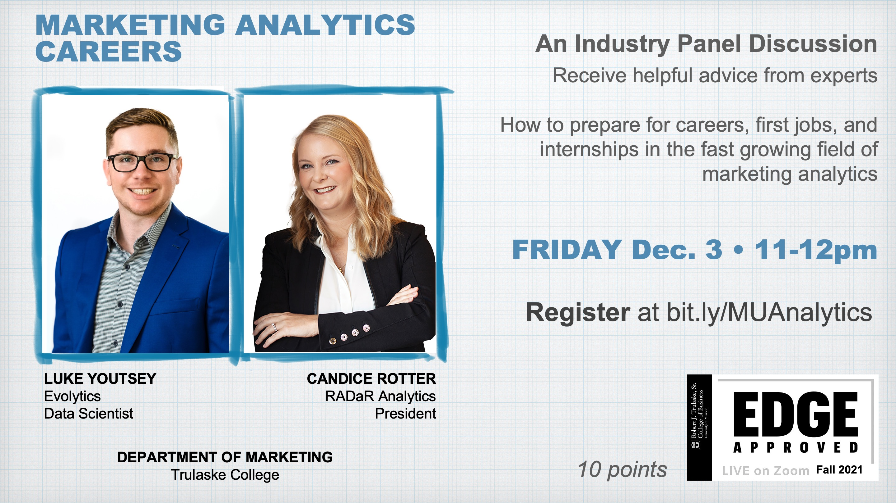
Notes:
There is an upcoming Marketing Analytics Industry Panel. This is an Edge-approved event, so registration will fill up quickly. If students want to attend, they should register this week, before the event is publicized to all business majors.

Slide 3
iClicker Question
How to improve R-squared in your regression model?
Include more relevant variables (i.e., those help predict Y)
Include more data points
Both A and B

Slide 4
iClicker Question
Is it possible to include a variable with more than 2 categories (i.e., class standing – freshman, sophomore, junior, senior?
Yes
No

Slide 5
iClicker Question
Is it possible to have categorial variables be the dependent variables?
Yes
No
Notes:
Logistic or probit regression

Slide 6




Chapter 18: Analysis and Interpretation Multiple Variables Simultaneously

Slide 7

Multiple Regression Implementation
R
Excel
Real Example

Slide 8
Learning Objectives
Discuss why a researcher might conduct a multivariate analysis
Explain the purpose and importance of cross tabulation
Describe a technique for comparing groups on a continuous dependent variable
Explain the difference between an independent sample t-test for means and a paired sample t-test for means
Discuss the Pearson product-moment correlation coefficient
Describe a technique for examining the influence of one or more predictor variables on an outcome variable

Slide 9
Why Use Multivariate Analysis?
Multivariate analyses allow researchers a closer look at their data than is possible with univariate analyses

Slide 10
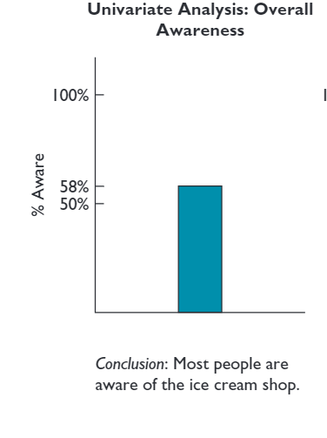
A Univariate Analysis Result

Slide 11
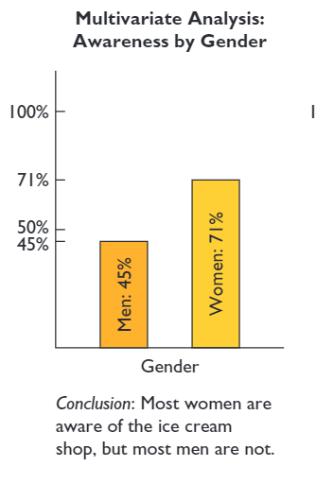
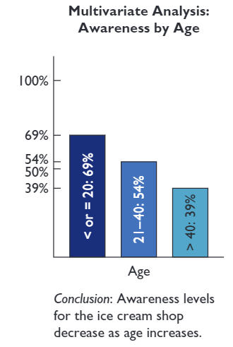
Multivariate Analysis Results: Enhanced Meaning

Slide 12
Cross Tabulation
A multivariate technique used for studying the relationship between two or more categorical variables. The technique considers the joint distribution of sample elements across variables

Slide 13
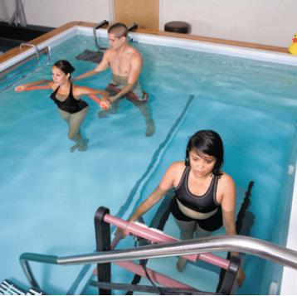
Back to the AFC Project
Question: Does being referred by a doctor to AFC lead to greater usage of the therapy pool?

Slide 14
Back to the AFC Project
Two Categorical variables:
Doctor referral (yes, no)
Pool Usage (yes, no)
In this situation,
Doctor referral would be considered the independent, or causal variable
Pool usage would be considered the dependent, or outcome variable.
This is an ideal situation for cross tabulation analysis

Slide 15
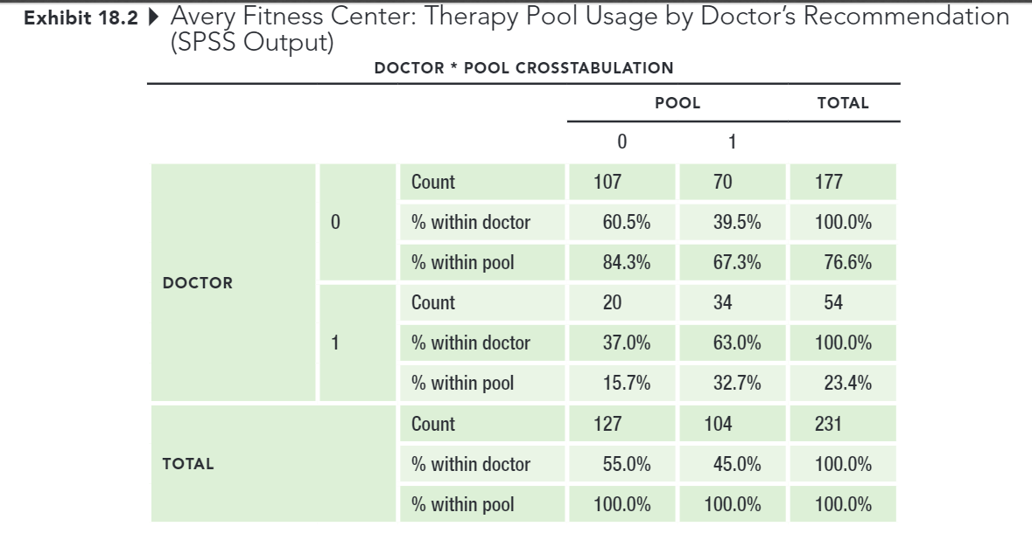
Back to the AFC Project
RAW SPSS OUTPUT

Slide 16
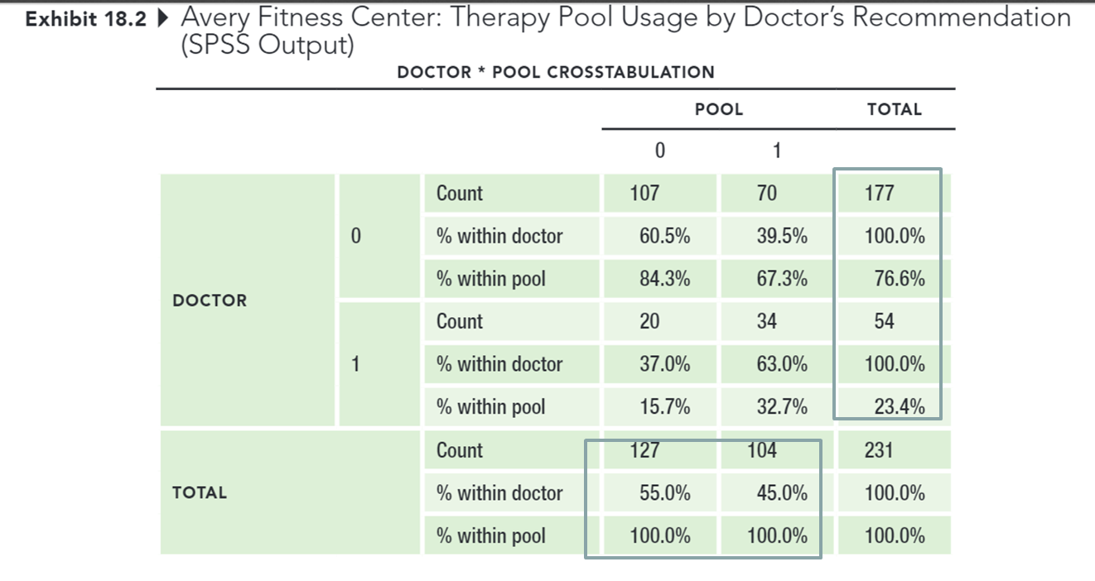
Back to the AFC Project
MARGINAL TOTALS

Slide 17
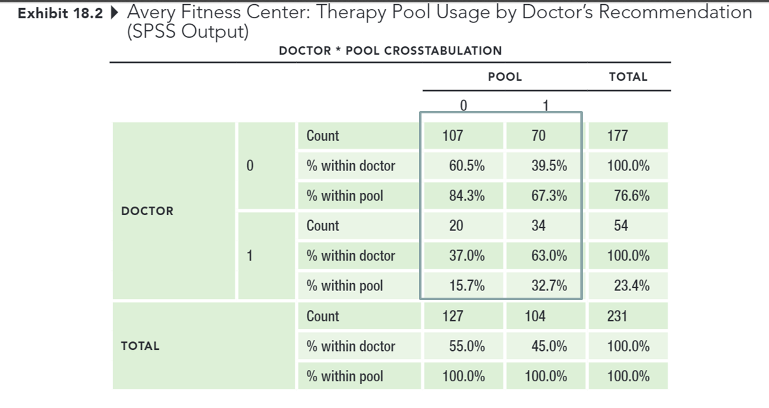
Back to the AFC Project
CELLS

Slide 18

Which Percentages Should I Use?
Always calculate percentages in the direction of the causal variable
Hint: Which variable might have caused the other to occur?

Slide 19
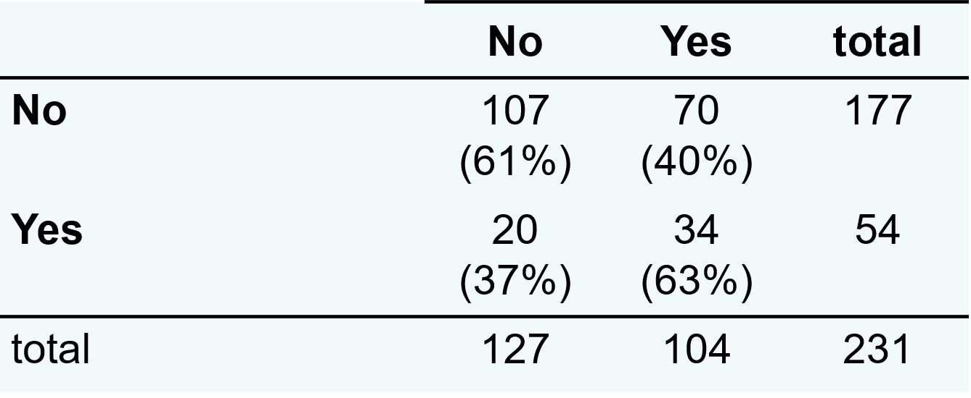
Presenting the Results
Doctor Recommendation?
Utilized Therapy Pool?

Slide 20
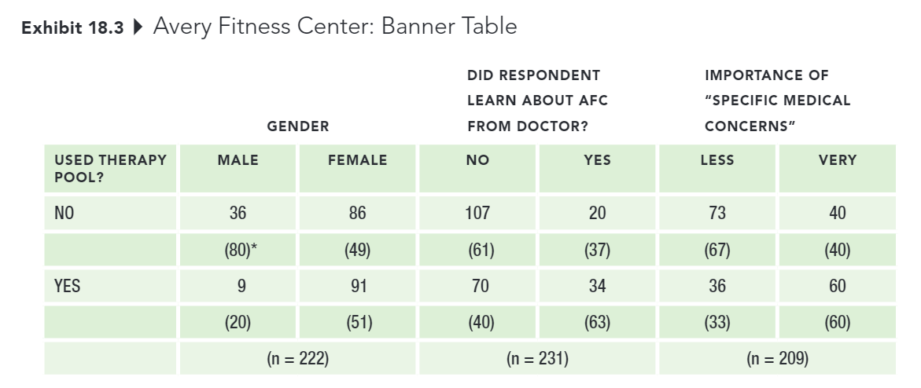
Presenting the Results
Banner: A series of cross tabulations between an outcome, or dependent variable, and serval (sometimes many) explanatory variables in a single table.

Slide 21

Cross-tabs: testing for Statistical Significance
Pearson Chi-square $χ^{2}$test of independence: A commonly used statistic for testing the null hypothesis that categorical variables are independent of one another.
Independent Sample t-test for means: A technique commonly used to determine whether two groups differ on some characteristic assessed on a continuous measure (e.g., satisfaction rating between men vs. women; age in years between customers vs. noncustomers)

Slide 22
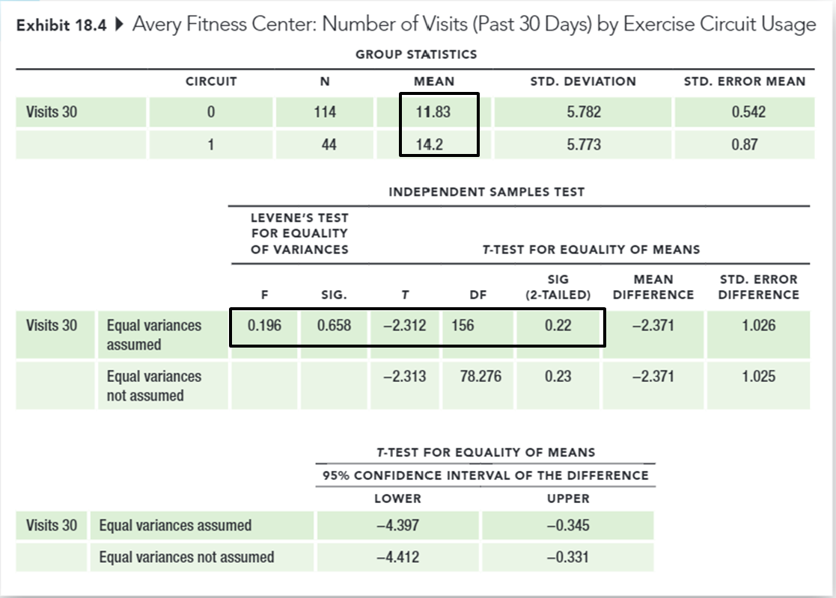
Cross-tabs: Testing for Statistical Significance
Does utilizing the exercise circuit (categorical independent variable) lead to increased number of visits to the center (continuous dependent variable)?

Slide 23
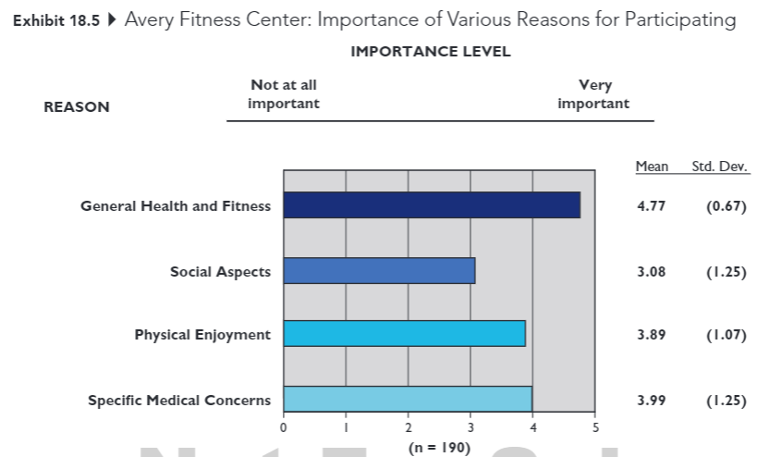
Cross-tabs: Testing for Statistical Significance
Paired Sample t-test: A technique for comparing two means when scores for both variables are provided by the same sample (e.g., before and after measures, applying same measure to different objects).

Slide 24
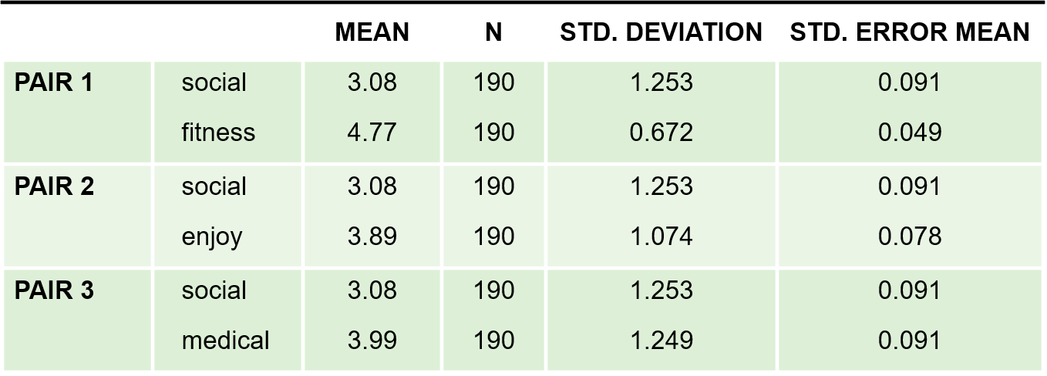
Cross-tabs: Testing for Statistical Significance
Exhibit 18.6 Avery Fitness Center: Paired Sample t-Tests (SPSS Output)
PAIRED SAMPLES STATISTICS
Do the mean attribute importance levels, provided by the same respondents, differ from one another?

Slide 25

Cross-tabs: Testing for Statistical Significance
Pearson product-moment correlation coefficient: A statistic that indicates the degree of linear association between two continuous variables. The correlation coefficient can range from -1 to +1

Slide 26
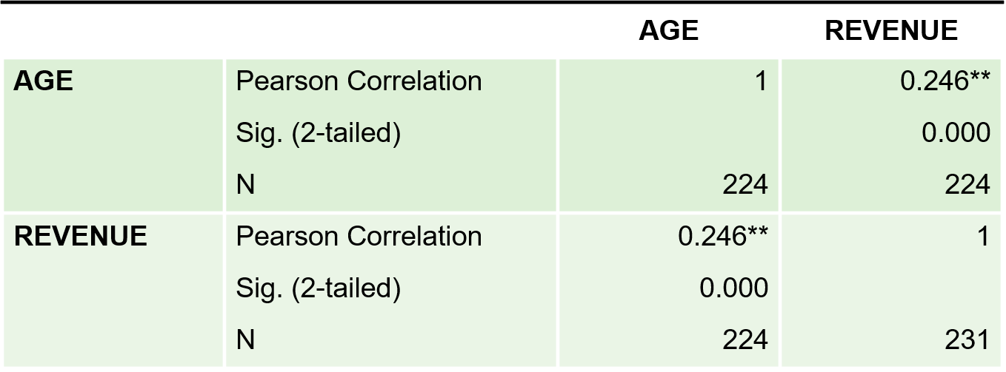
Cross-tabs: Testing for Statistical Significance
Exhibit 18.7 Avery Fitness Center: Correlation Between Age and Revenues (SPSS Output)
CORRELATIONS
Is there a correlation between age (continuous indent variable) and fees paid (continuous dependent variable)?

Slide 27
Cross-tabs: Testing for Statistical Significance
Ice cream purchases and murder rates are positively correlated
Notes:
Thankfully, correlation is not the same thing as causation.

Slide 28

Cross-tabs: Testing for Statistical Significance
Regression analysis: A statistical technique used to derive an equation representing the influence of a single (simple regression) or multiple (multiple regression) independent variables on a continuous dependent, or outcome variable

Slide 29
Cross-tabs: Testing for Statistical Significance
Question: What are some of the factors that drive revenues at AFC?
Regress revenues on
(1) member age and the importance of
(2) general health and fitness
(3) Social aspects
(4) Physical enjoyment
(5) Specific medical concerns as the reason for visiting AFC

Slide 30
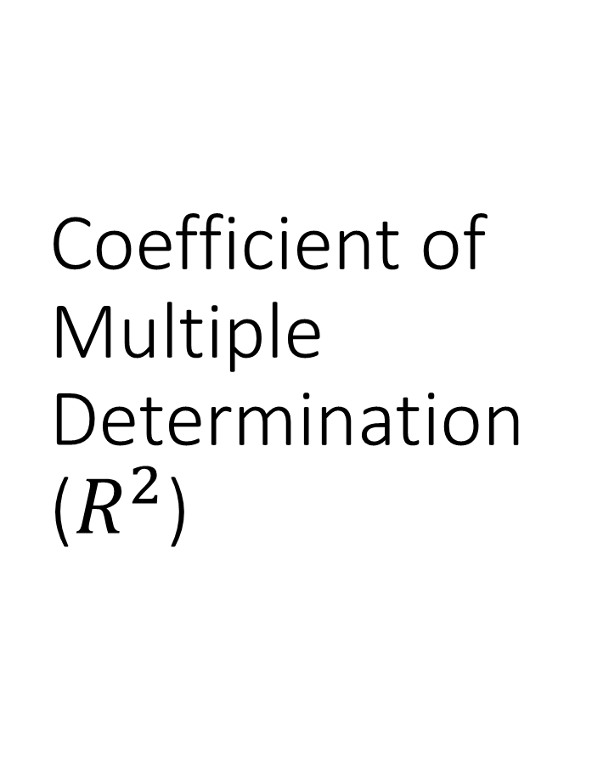
Coefficient of Multiple Determination ($R^{2}$)
A measure representing the relative proportion of the total variation in the dependent variable that can be explained or accounted for by the fitted regression equation. When there is only one predictor viable, this value is referred to as the coefficient of determination.

Slide 31
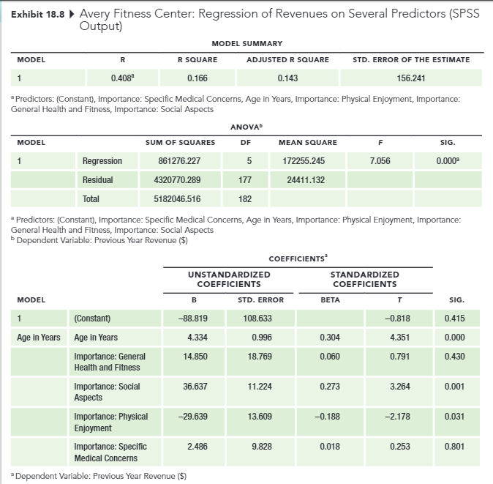
Coefficient of Multiple Determination

Slide 32
Key Steps in Interpreting Multiple Regression Results
Does the set of predictors explain a statistically significant portion of variation in the dependent variable? (look at the ANOVA table results)
1
How much of the variation in the dependent viable does our set of predictors explain?
2
Which of the individual predictors explain variation in the dependent variable, and what is the directions of the relationship (positive or negative)? (look at the t-values and p-values of the individual predictors)
3

Slide 33
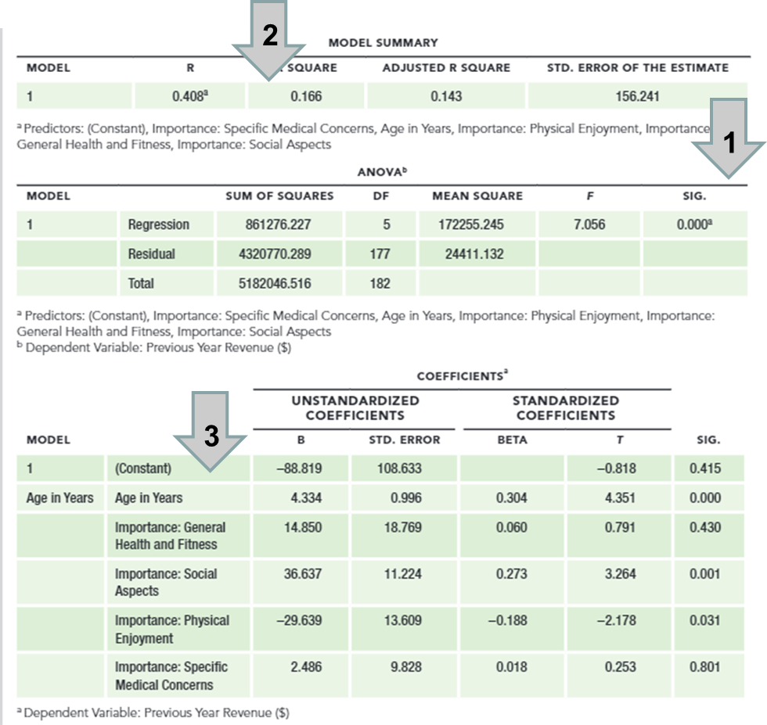
Key Steps in Interpreting Multiple Regression Results

Slide 34


Notes on Multiple Regression
Introduction to Multiple Regression
Real-world data are messy
Additional training: Marketing Analytics certificate
Notes:
These class sessions have given you an introduction to regression analysis and shown you a few of the ways it can be used by companies.
Actually conducting regression analysis requires additional training to avoid making analysis and interpretation errors.
Students who enjoyed the material on correlation and regression should consider getting a marketing analytics certificate. In that coursework, you’ll learn the technical details of running regression analysis plus many other ways data can be analyzed to help companies make marketing decisions.

Slide 35
Presentation Guidelines
Pointers on Presentation
Format: PowerPoint (recommended), Google Slides, Prezi
No back monitor (to resemble a business setting)
Slide tips
Sample Slides
Time: 15 minutes (under or over = 1 point deduction)
Q&A: 5 minutes
Grade is based on Presentation Evaluation Form (next class)
Notes:
Please remember that for the first 3 groups, I will be more lenient because they go first.
You don’t need suit and tie, but since this is a business presentation, hence professional dress is expected.
Update about the order of presentation. I’ve checked with the syllabus, and the two dates are November 17th and 29th instead of November 29th and December 8th
But in either case, there shouldn’t be a problem since all of you will be in class anyway. And the order of presentation for the two dates remain constant.
Please let me know if your group would like to change the order, I can ask other groups if they want to change with you.
Go over the sample slides link (cover expectation as well)
Each team will have 20 mins
15 mins to present the project
5 mins for discussion and questions
Sign-up Sheet
2 class sessions

Slide 36
Presentation Critique
Notes:
Go over how to do presentation critique

Slide 37
Report
Notes:
Talk about the expected format of the report

Slide 38
10-min Group Discussion
Initial Data Analysis
Presentation Guidelines
Presentation Critique
Report

Slide 39
5-min snippet

